Slide 1

18ECC303J – Computer Communication Networks
Course Credit : 4
Theory : 9 Hours
1. Behrouz A. Forouzan, “Data communication & Networking”, Mc-Graw Hill, 5th Edition Reprint, 2014.
2. Andrew S. Tanenbaum, “Computer Networks”, Pearson Education India, 5th Edition, 2013.
3. William Stallings, “Data & Computer Communication”, Pearson Education India, 10th Edition, 2014.

Slide 2
Unit-2 : OSI Lower Layers
OSI Network models
Layered Architecture
Data Link Layer - Introduction
Link Layer Addressing
Error detection and Correction
Data Link control – LLC
Data Link control – MAC
Flow and Error Control Protocol
ARQ Schemes
HDLC protocol

Slide 3
Unit 2 –Week 4
Session 7
Network models
OSI layer Architecture
Session 8
Data Link Layer
Link Layer Addressing
Session 9
Error detection

Slide 4
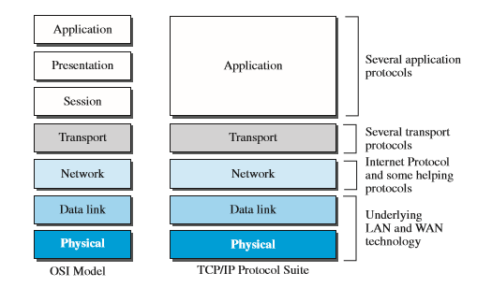
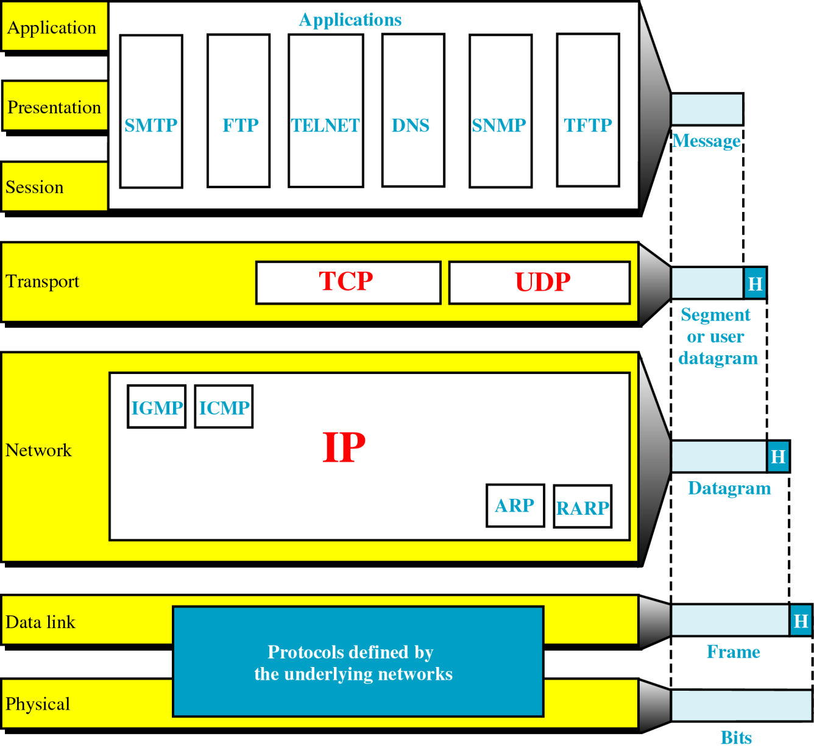
Network Models
Two models have been devised to define computer network operations
OSI model
TCP/IP model

Slide 5
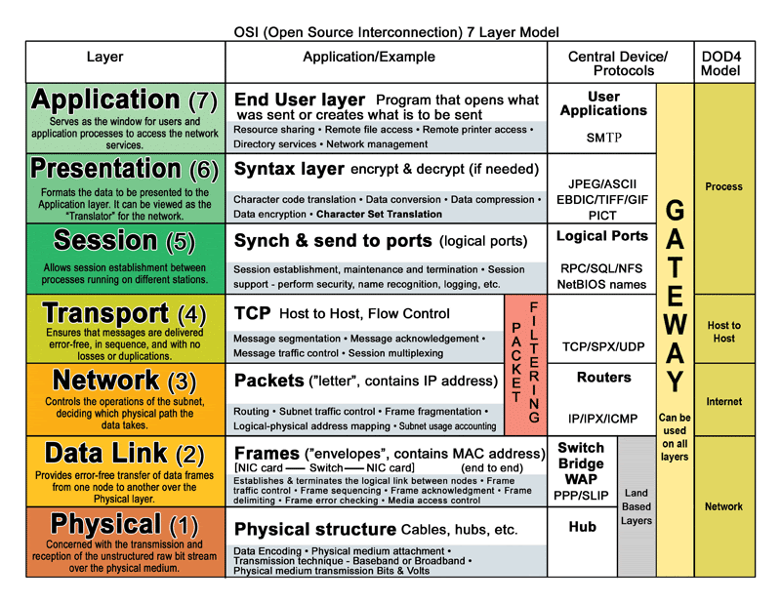
OSI Layered Architecture

Slide 6
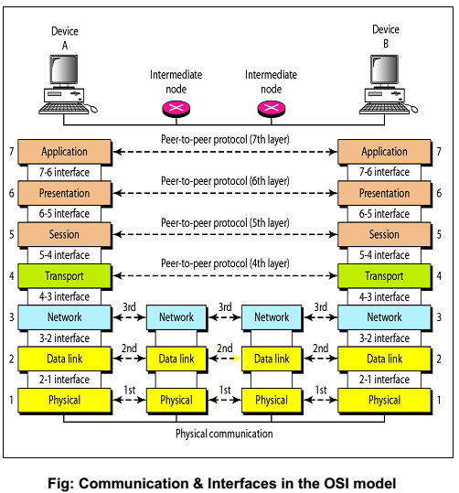
Layer communication & Interfaces

Slide 7
Layer communication & Interfaces
The processes on each machine that communicate at a given layer are called peer-to-peer processes.
Organization of Layers
The seven layers can be thought of as belonging to three subgroups.
Layers 1, 2, and 3 (Physical, Data link, and Network) are Network support layers
It deals with the physical aspects of moving data from one device to another.
Layers 5, 6, and 7 (Session, Presentation, and Application) are User support layers that allows interoperability among unrelated software systems.
Layer 4, Transport layer, links the two subgroups and ensures that what the lower layers have transmitted is in a form that the upper layers can use.
If you are a sender, the layer operates from Layer 7 to Layer 1, if you are a receiver, the layer operated from Layer 1 to Layer 7.
At each layer, a header, and possibly a trailer, is added to the data unit. This is called encapsulation.
When the data unit passes through the physical layer, it is changed into an electromagnetic signal and transmitted across a physical link.

Slide 8
Physical layer
The main functions of this layer are to transmit a bit stream over a physical medium.
It deals with the mechanical and electrical specifications of the interface and transmission medium.
It also defines the procedures and functions that physical devices and interfaces have to perform for transmission to occur. Other responsibilities include:
➢ Physical characteristics of interfaces and medium
It defines the
o characteristics of the interface between devices and transmission medium, Type of medium.
➢ Representation of bits—
To be transmitted, bits must be encoded into signals - electrical or optical.
The physical layer defines the type of encoding.

Slide 9
Physical Layer

Slide 10
Continued…
Data rate
It defines the transmission rate (number of bits sent per second).
Synchronization of bits
The sender and receiver must be synchronized at the bit level.
Line configuration
The physical layer is concerned with the connection of devices to the media (point-to-point or multipoint configuration).
Physical topology
It defines how devices are connected (mesh, star, ring, bus or hybrid) to make a network.
Transmission mode
The physical layer also defines the direction of transmission between two devices: simplex, half-duplex, or full-duplex

Slide 11
Data Link Layer
The data link layer transforms a raw transmission facility to a reliable link.
It is responsible for node to node delivery
It makes the data appear error-free to the upper layer (network layer).
Other responsibilities include:
Framing
The data link layer divides the stream of bits received from the network layer into manageable data units called frames.
Physical addressing
If frames are to be distributed to different systems on the network

Slide 12
Continued…
If destination is outside the sender's network, the receiver address is the address of the device that connects the network to the next one.
Flow control
If the receiving rate is less than the transmission rate, the data link layer imposes a flow control mechanism to avoid overwhelming the receiver.
Error control
The data link layer adds reliability to the physical layer by adding a trailer to detect and retransmit damaged/lost frames and to recognize duplicate frames.
Access control
When two or more devices are connected to the same link, a data link layer protocol determines which device has control over the link at any given time.

Slide 13
Network Layer
The network layer is responsible for the source-to-destination delivery of a packet.
If the two systems are attached to different networks with connecting devices between the networks, there is often a need for the network layer to accomplish source-to-destination delivery.
➢ Logical addressing
The physical addressing given by the data link layer handles the addressing problem locally.
If a packet passes the network boundary, then logical addressing system is required to help distinguish the source and destination systems.
➢ Routing
When independent networks or links are connected to create internetworks (network of networks) or a large network, the connecting devices (called routers or switches) route or switch the packets to destination.

Slide 14
Transport Layer
The transport layer is responsible for source to destination (process-to-process) delivery of the entire message.
A process is an application program running on a host.
It treats each one independently, as though each piece belonged to a separate message, whether or not it does.
The transport layer, on the other hand, ensures that the whole message arrives intact and in order, overseeing both error control and flow control at the source-to-destination level.
Other responsibilities of the transport layer include:
Service-point addressing
A source-to-destination delivery means delivery not only from one computer to the next but also from a specific process on one computer to a specific process on the other.

Slide 15
Transport layer
Segmentation and reassembly
A message is divided into transmittable segments, with each segment containing a sequence number.
These numbers enable the transport layer to reassemble the message correctly upon arriving at the destination and to identify and replace packets that were lost in transmission.
Connection control
A connectionless transport layer treats each segment as an independent packet and delivers it to the transport layer at the destination machine.
A connection oriented transport layer makes a connection with the transport layer at the destination machine first before delivering the packets. After all the data are transferred, the connection is terminated.
Flow control
The flow control at this layer is performed end to end.
Error control
The error control at this layer is performed process-to-process.
The sending transport layer makes sure that the entire message arrives at the receiving transport layer without error (damage, loss, or duplication).

Slide 16
Session Layer
The session layer is the network dialog controller.
It establishes, maintains, and synchronizes the interaction among communicating systems.
Specific responsibilities of the session layer include the following:
Dialog control
It allows two systems to enter into a dialog and communication between two processes to take place in either half-duplex / full-duplex mode.
Synchronization
The session layer allows a process to add checkpoints, or synchronization points, to a stream of data.
For example, if a system is sending a file of 2000 pages, it is advisable to insert checkpoints after every 100 pages to ensure that each 100-page unit is received and acknowledged independently.
If a crash happens during the transmission of page 523, the pages 501 to 523 will be resent.

Slide 17
Presentation layer
The presentation layer is concerned with the syntax and semantics of the information exchanged between two systems.
Syntax means- the format and the coding scheme used for the information exchange between peer layers
Semantics – the interpretation of control information for synchronization, coordination and error handling
The main functions of this layer is translation, encryption/decryption and compression/decompression
Specific responsibilities of the presentation layer include:
Translation
Different computers use different encoding systems, the presentation layer is responsible for interoperability between these different encoding methods.
The presentation layer at the sender changes the information from its sender-dependent format into a common format. The presentation layer at the receiving machine changes the common format into its receiver-dependent format.

Slide 18
Presentation layer
Encryption
To carry sensitive information, a system must ensure privacy.
The sender transforms the information into another form (encryption) before sending.
The receiver transforms the encrypted message back to its original form (decryption).
Compression
Data compression reduces the number of bits contained in the information.
It is particularly important in multimedia transmission.

Slide 19
Application Layer
The application layer enables the user, whether human or software, to access the network.
It provides user interfaces and support for services such as electronic mail, remote file access and transfer, shared database management, and other types of distributed information services.
Specific services provided by the application layer include:
Network virtual terminal—
A network virtual terminal is a software version of a physical terminal, and it allows a user to log on to a remote host.
To do so, the application creates a software emulation of a terminal at the remote host.
The user's computer talks to the software terminal which in turn, talks to the host, and vice versa.

Slide 20
Review Questions
When the communication is complex, we may need to divide the task between different layers, in which case we need____.
The network layer is responsible for the _____ delivery of a packet.
A ____is a software version of a physical terminal, and it allows a user to log on to a remote host.
A ___ is an application program running on a host.

Slide 21
Answers
Protocol Layering
Source to destination
Network virtual Terminal
Process

Slide 22
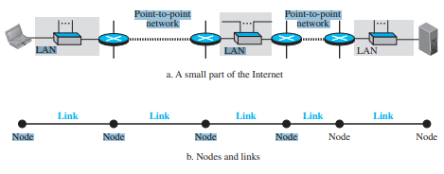
Data Link Layer
The data-link layer is located between the physical and the network layers.
The data-link layer provides services to the network layer; it receives services from the physical layer
Communication at the data-link layer is node-to-node.
A data unit from one point in the Internet needs to pass through many networks (LANs and WANs) to reach another point.
These LAN and WAN are connected by routers.
Two end hosts and the routers as nodes and the networks in between as links

Slide 23
Services of Data-link layer
Framing
Link layer addressing
Flow Control
Error Control
Framing : First service provided by the data-link layer is framing
When a packet is travelling in the Internet, the data-link layer of a node (host or router) is responsible for delivering a datagram to the next node in the path.
Data-link layer of the sending node needs to encapsulate the datagram received from the network in a frame. Data-link layer of the receiving node needs to decapsulate the datagram from the frame.
Encapsulation and Decapsulation is needed at each intermediate node.
Reason: Each link may be using a different protocol with a different frame format. Even if one link and the next are using the same protocol, encapsulation and decapsulation are needed because the link-layer addresses are normally different.

Slide 24
Link Layer Addressing
In a connectionless internetwork such as the Internet we cannot make a datagram reach its destination using only IP addresses.
The reason is that each datagram in the Internet, from the same source host to the same destination host, may take a different path.
The source and destination IP addresses define the two ends but cannot define which links the datagram should pass through.
We need to remember that the IP addresses in a datagram should not be changed. If the destination IP address in a datagram changes, the packet never reaches its destination; if the source IP address in a datagram changes, the destination host or a router can never communicate with the source if a response needs to be sent back or an error needs to be reported back to the source
We need another addressing mechanism in a connectionless internetwork: the link-layer addresses of the two nodes.
A link-layer address is sometimes called a link address, sometimes a physical address, and sometimes a MAC address.
Since a link is controlled at the data-link layer, the addresses need to belong to the data-link layer.

Slide 25
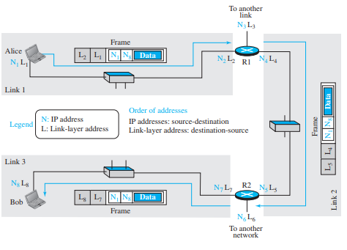
When a datagram passes from the network layer to the data-link layer, the datagram will be encapsulated in a frame and two data-link addresses are added to the frame header. These two addresses are changed every time the frame moves from one link to another.

Slide 26
Consider the figure shown in previous slide:
We have three links and two routers.
Two hosts: Alice as source and Bob as destination.
For each host, we have shown two addresses, the IP addresses (N) and the link-layer addresses (L).
A router has as many pairs of addresses as the number of links the router is connected to.
In the figure in the previous slide, it is shown three frames, one in each link.
Each frame carries the same datagram with the same source and destination addresses (N1 and N8), but the link-layer addresses of the frame change from link to link.
In link 1, the link-layer addresses are L1 and L2.
In link 2, they are L4 and L5.
In link 3, they are L7 and L8.
Note that the IP addresses and the link-layer addresses are not in the same order.
For IP addresses, the source address comes before the destination address;
For link-layer addresses, the destination address comes before the source

